Slide 1


Welcome
Current/Future
IB Booster Members!

Slide 2

YOUR
MEMBERSHIP
GOES A LONG WAY!
HERE’S WHAT WE DO…
WE HOPE YOU JOIN US
Notes:
This template can be used as a starter file for presenting training materials in a group setting.
Sections
Sections can help to organize your slides or facilitate collaboration between multiple authors. On the Home tab under Slides, click Section, and then click Add Section.
Notes
Use the Notes pane for delivery notes or to provide additional details for the audience. You can see these notes in Presenter View during your presentation.
Keep in mind the font size (important for accessibility, visibility, videotaping, and online production)
Coordinated colors
Pay particular attention to the graphs, charts, and text boxes.
Consider that attendees will print in black and white or grayscale. Run a test print to make sure your colors work when printed in pure black and white and grayscale.
Graphics, tables, and graphs
Keep it simple: If possible, use consistent, non-distracting styles and colors.
Label all graphs and tables.

Slide 3
Your Membership funds:
Classroom support and events for teachers
All IB celebrations for your child, such as:
  Freshman Camp & Team-building event
  Sophomore Breakfast
  Junior Pinning Ceremony
  Coffeehouse event
  Senior Celebration
  Learner profiles of the month for each grade
  Jr/Sr Friendsgiving event
  Senior Scholarship
Notes:
Give a brief overview of the presentation. Describe the major focus of the presentation and why it is important.
Introduce each of the major topics.
To provide a road map for the audience, you can repeat this Overview slide throughout the presentation, highlighting the particular topic you will discuss next.

Slide 4
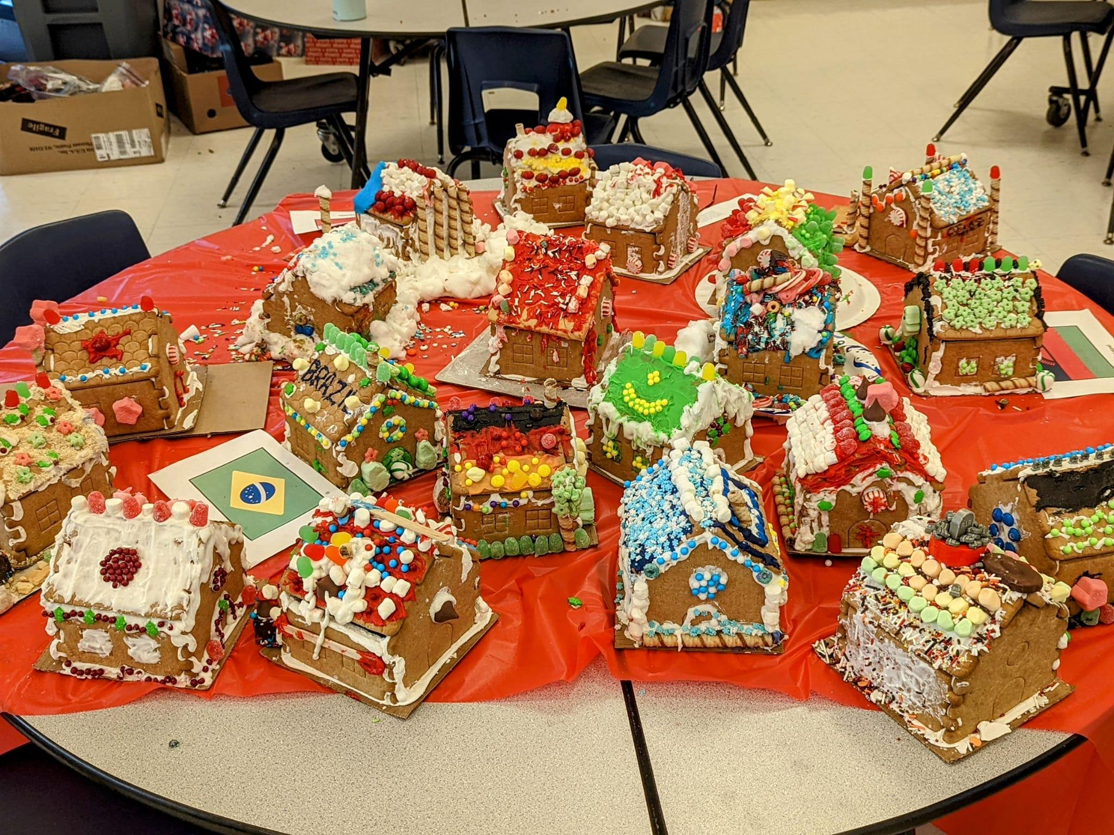
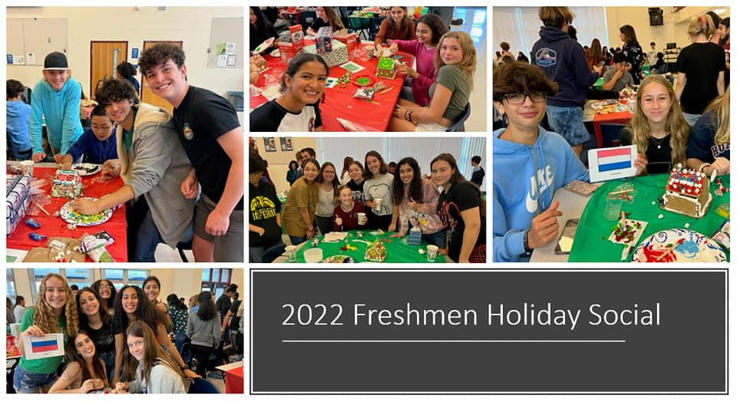
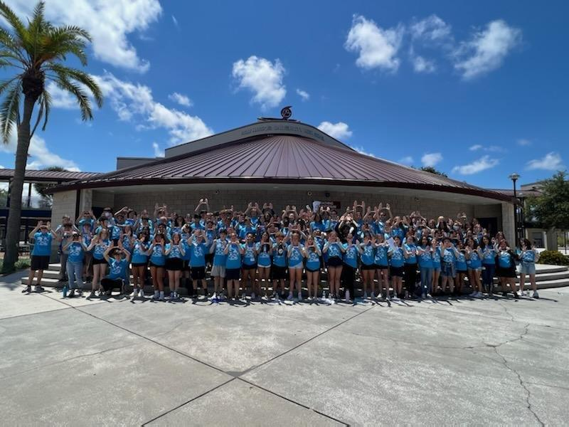
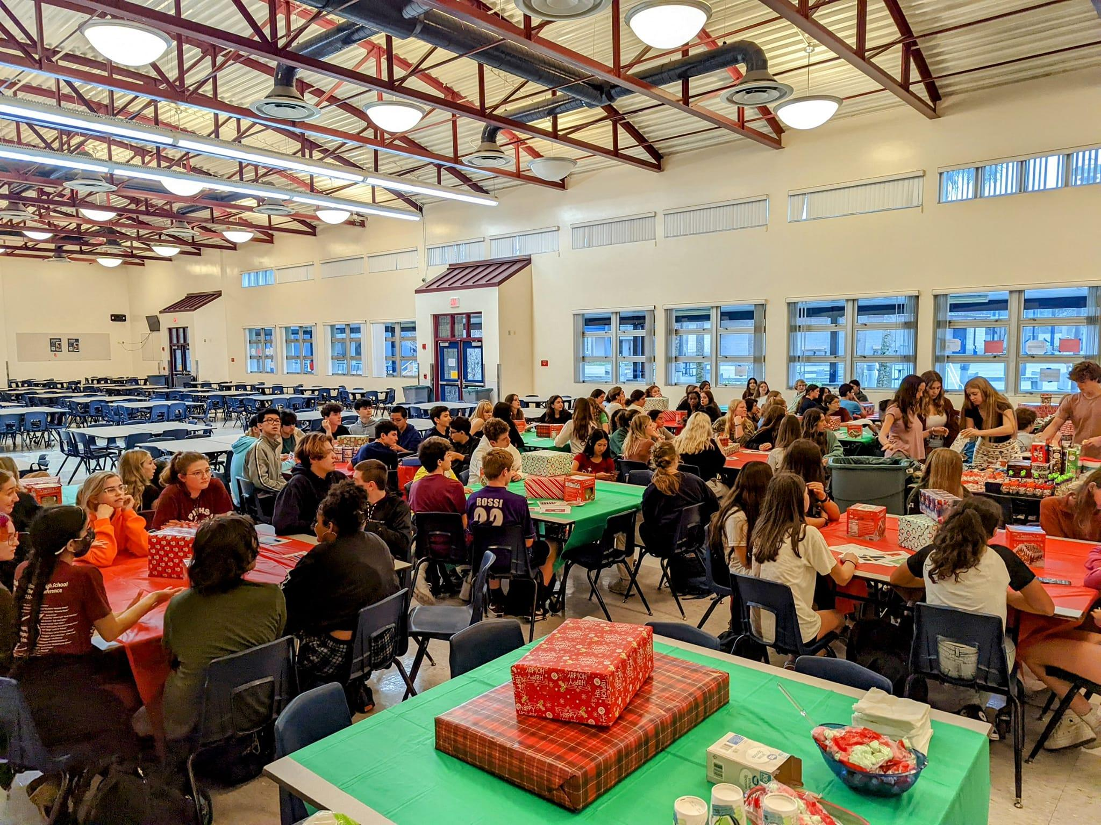
Freshman Team-building Events
Freshman Camp
Notes:
Is your presentation as crisp as possible? Consider moving extra content to the appendix.
Use appendix slides to store content that you might want to refer to during the Question slide or that may be useful for attendees to investigate deeper in the future.

Slide 5
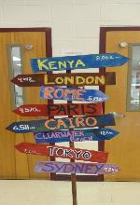
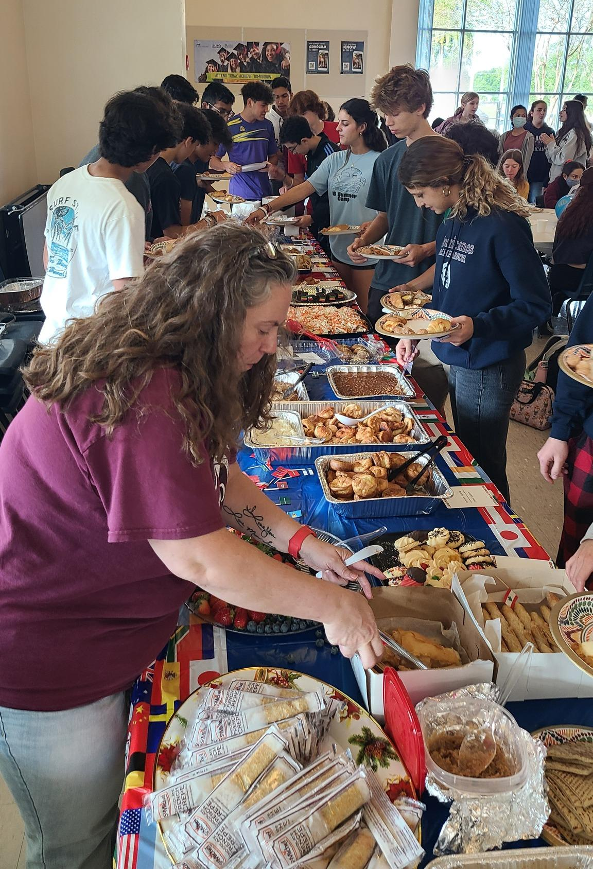
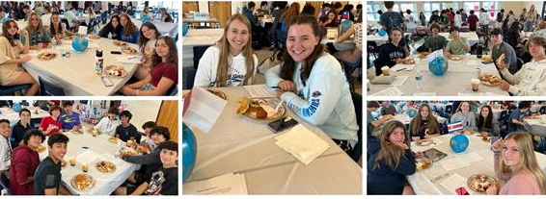
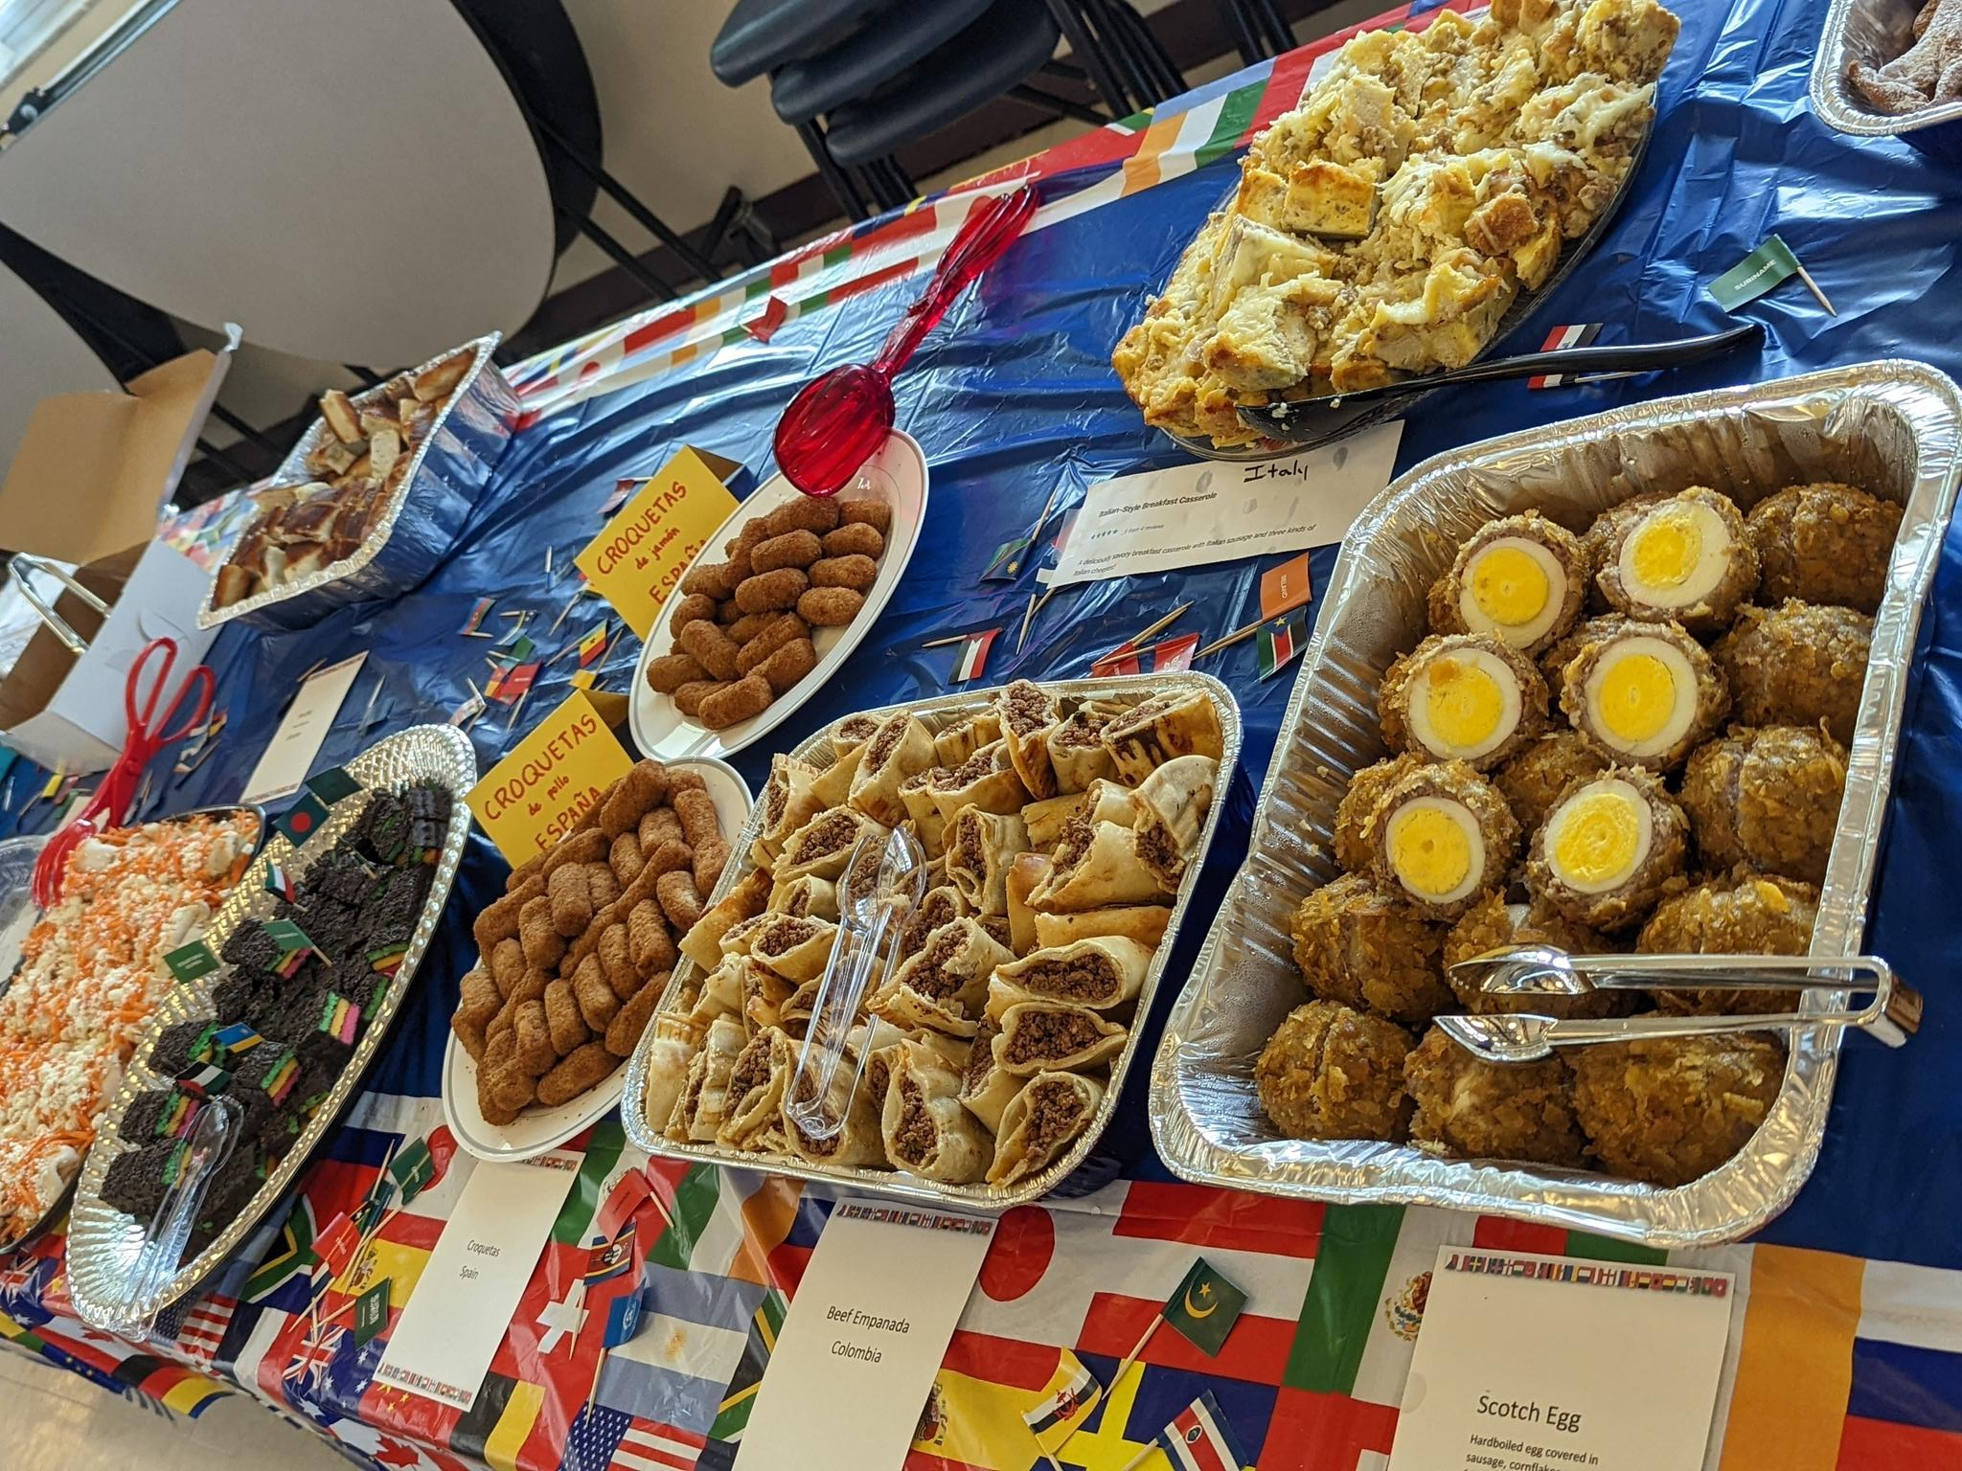
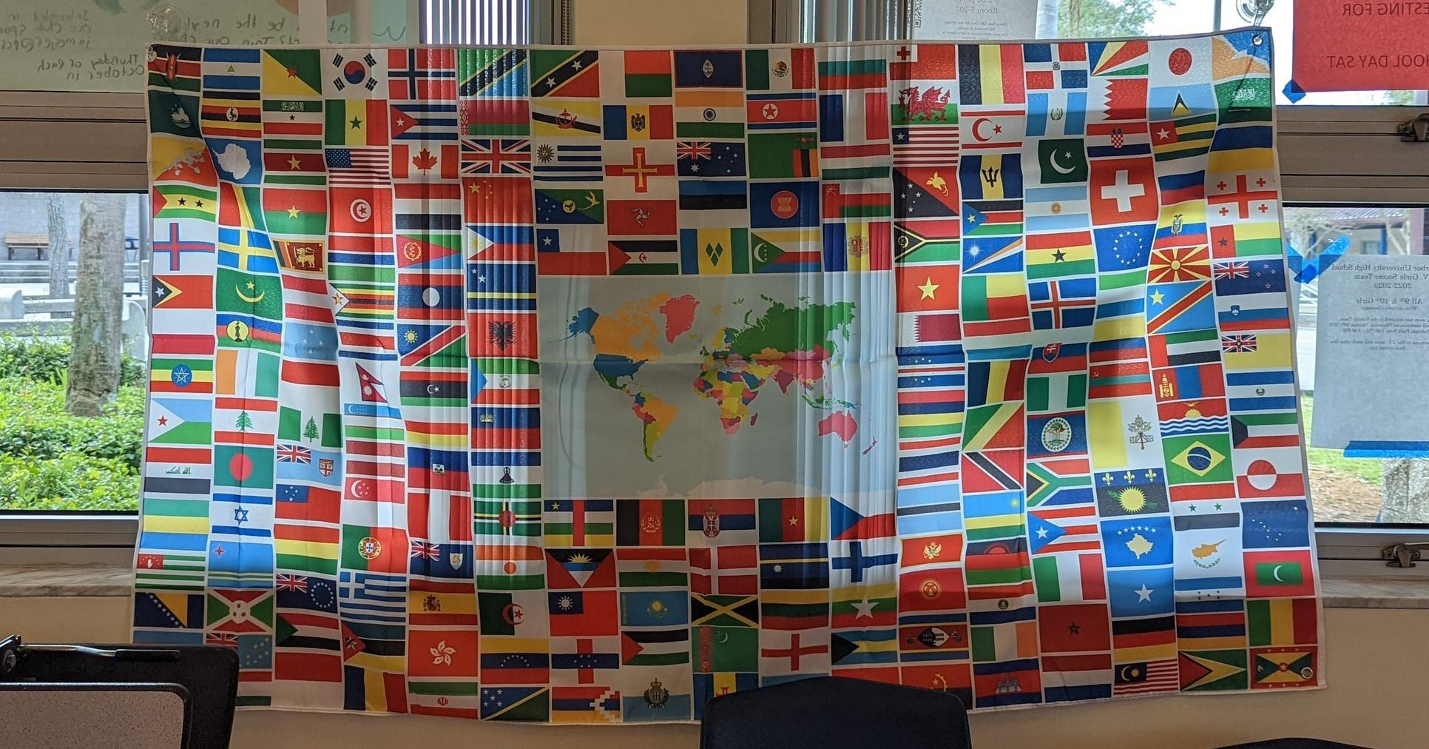
IB Sophomore Breakfast
Notes:
This template can be used as a starter file for presenting training materials in a group setting.
Sections
Sections can help to organize your slides or facilitate collaboration between multiple authors. On the Home tab under Slides, click Section, and then click Add Section.
Notes
Use the Notes pane for delivery notes or to provide additional details for the audience. You can see these notes in Presenter View during your presentation.
Keep in mind the font size (important for accessibility, visibility, videotaping, and online production)
Coordinated colors
Pay particular attention to the graphs, charts, and text boxes.
Consider that attendees will print in black and white or grayscale. Run a test print to make sure your colors work when printed in pure black and white and grayscale.
Graphics, tables, and graphs
Keep it simple: If possible, use consistent, non-distracting styles and colors.
Label all graphs and tables.

Slide 6
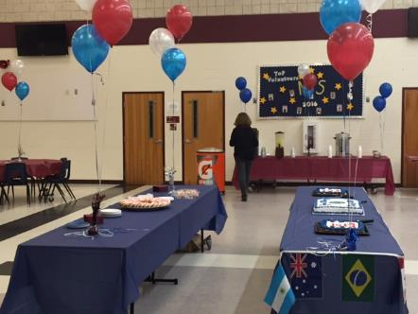
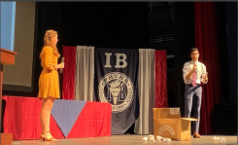
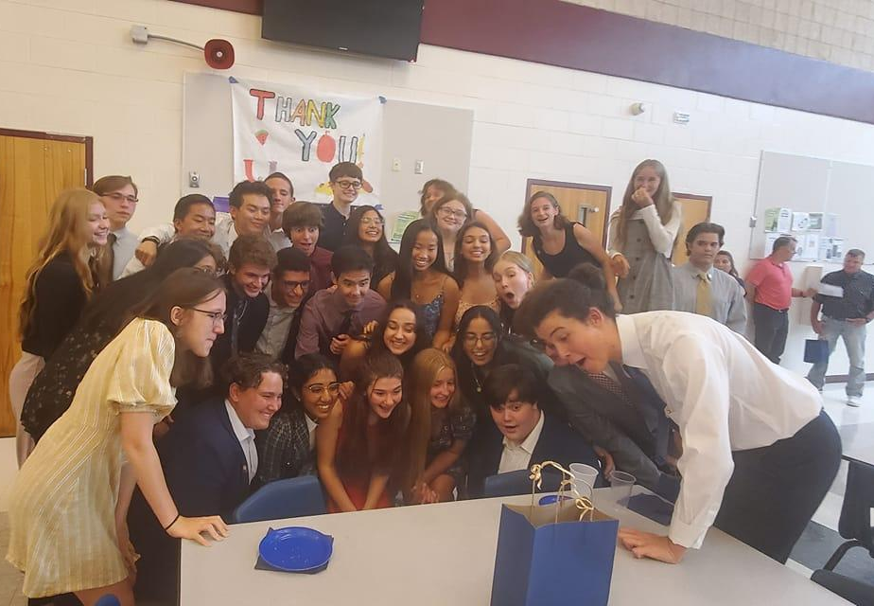
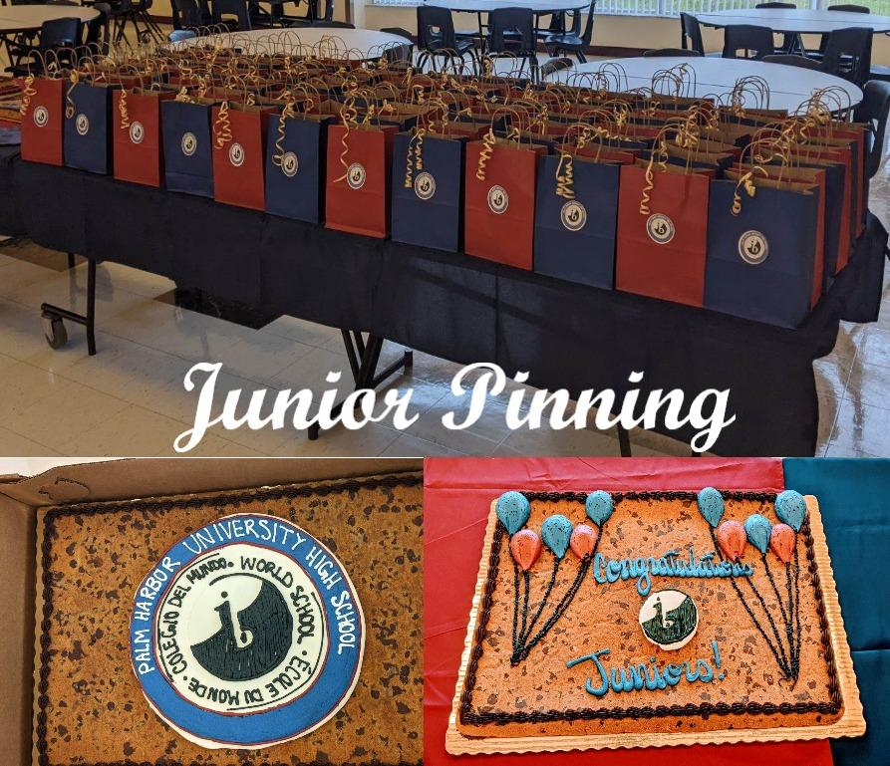
IB Junior Pinning
Notes:
What will the audience be able to do after this training is complete? Briefly describe each objective and how the audience will benefit from this presentation.

Slide 7

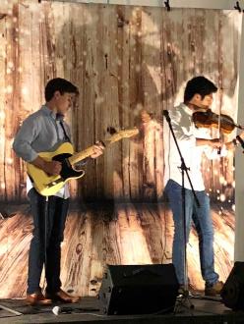

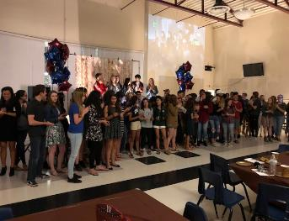
IB COFFEE HOUSE
Notes:
This template can be used as a starter file for presenting training materials in a group setting.
Sections
Sections can help to organize your slides or facilitate collaboration between multiple authors. On the Home tab under Slides, click Section, and then click Add Section.
Notes
Use the Notes pane for delivery notes or to provide additional details for the audience. You can see these notes in Presenter View during your presentation.
Keep in mind the font size (important for accessibility, visibility, videotaping, and online production)
Coordinated colors
Pay particular attention to the graphs, charts, and text boxes.
Consider that attendees will print in black and white or grayscale. Run a test print to make sure your colors work when printed in pure black and white and grayscale.
Graphics, tables, and graphs
Keep it simple: If possible, use consistent, non-distracting styles and colors.
Label all graphs and tables.

Slide 8
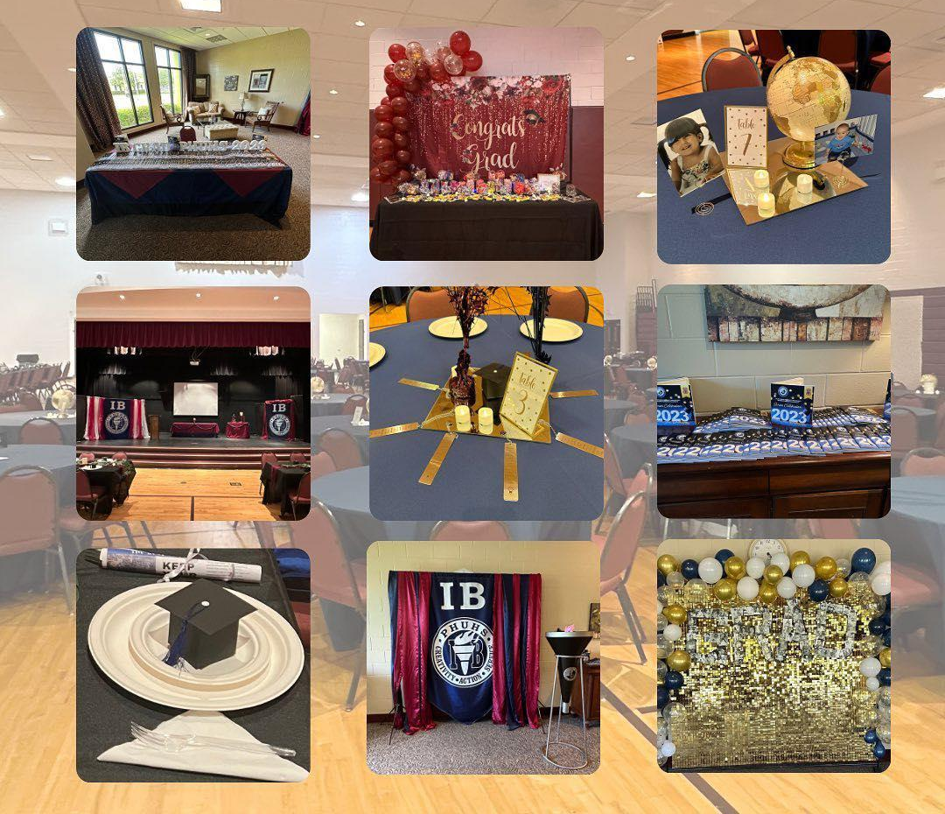
IB SENIOR CELEBRATION

Slide 9

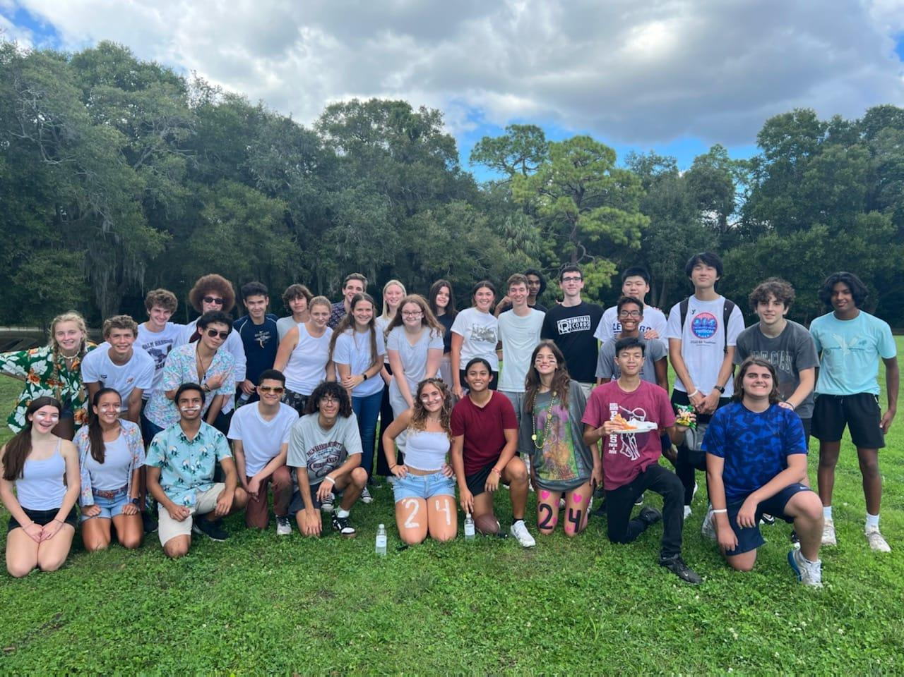
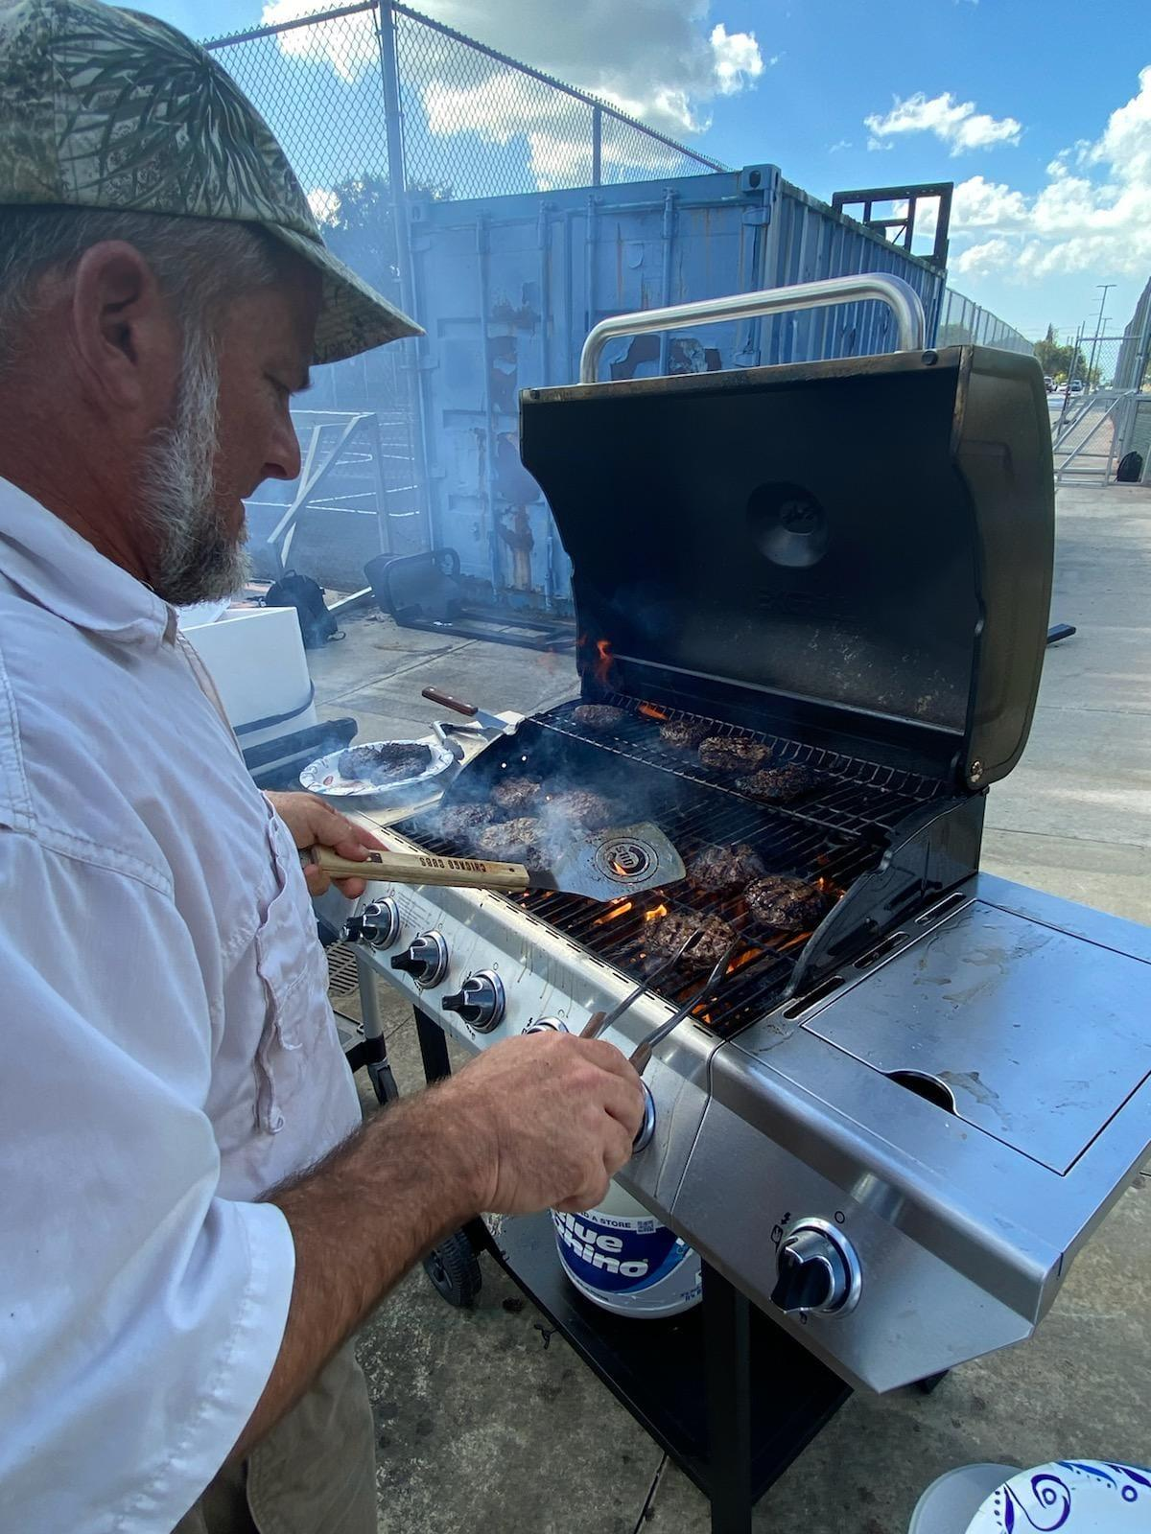
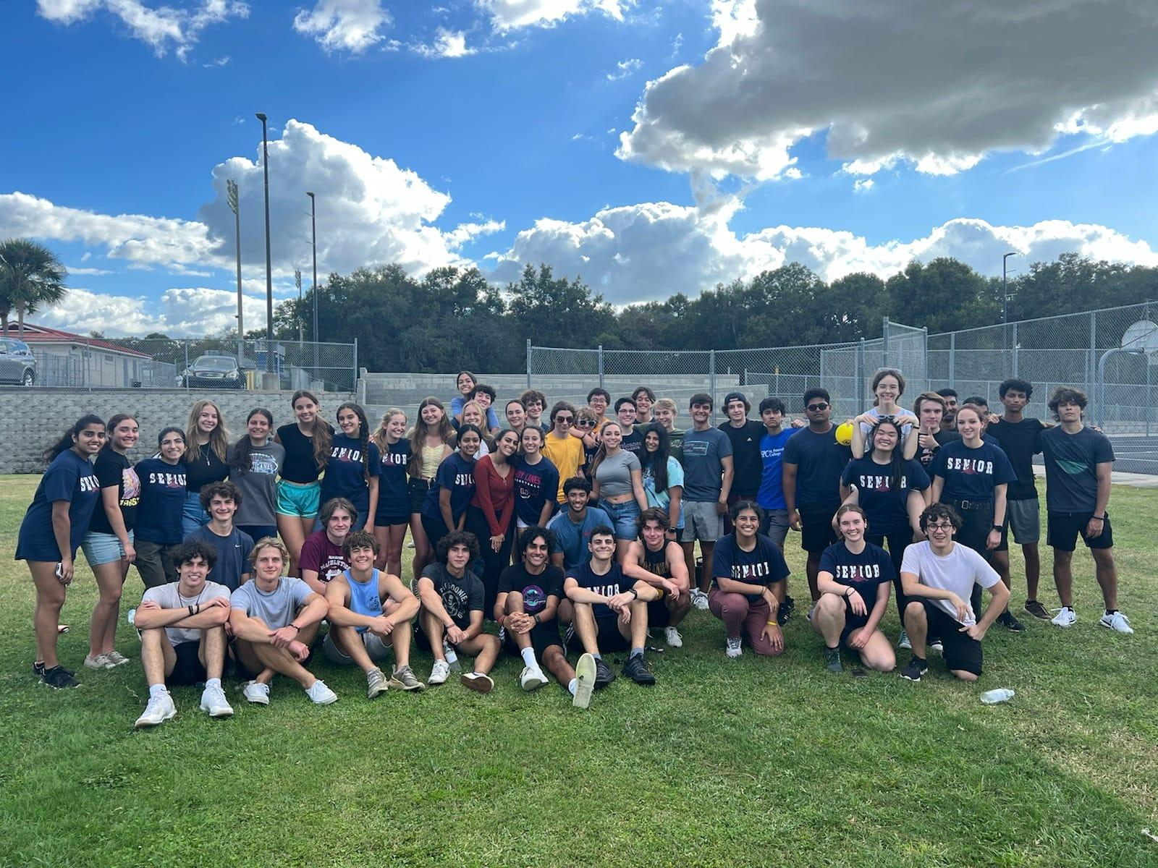


Jr/Sr Friendsgiving
Learner Profiles of the month
HELP WITH TEACHERS’ SUPPLIES
CAS MEDALS
Award Scholarships

Slide 10
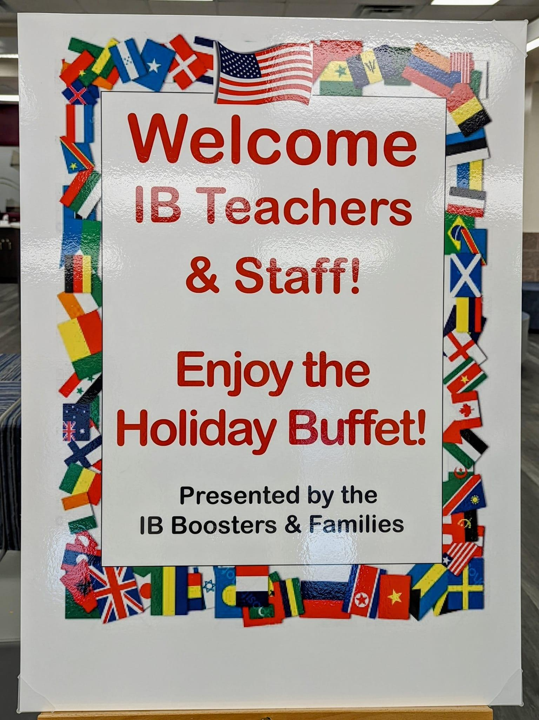
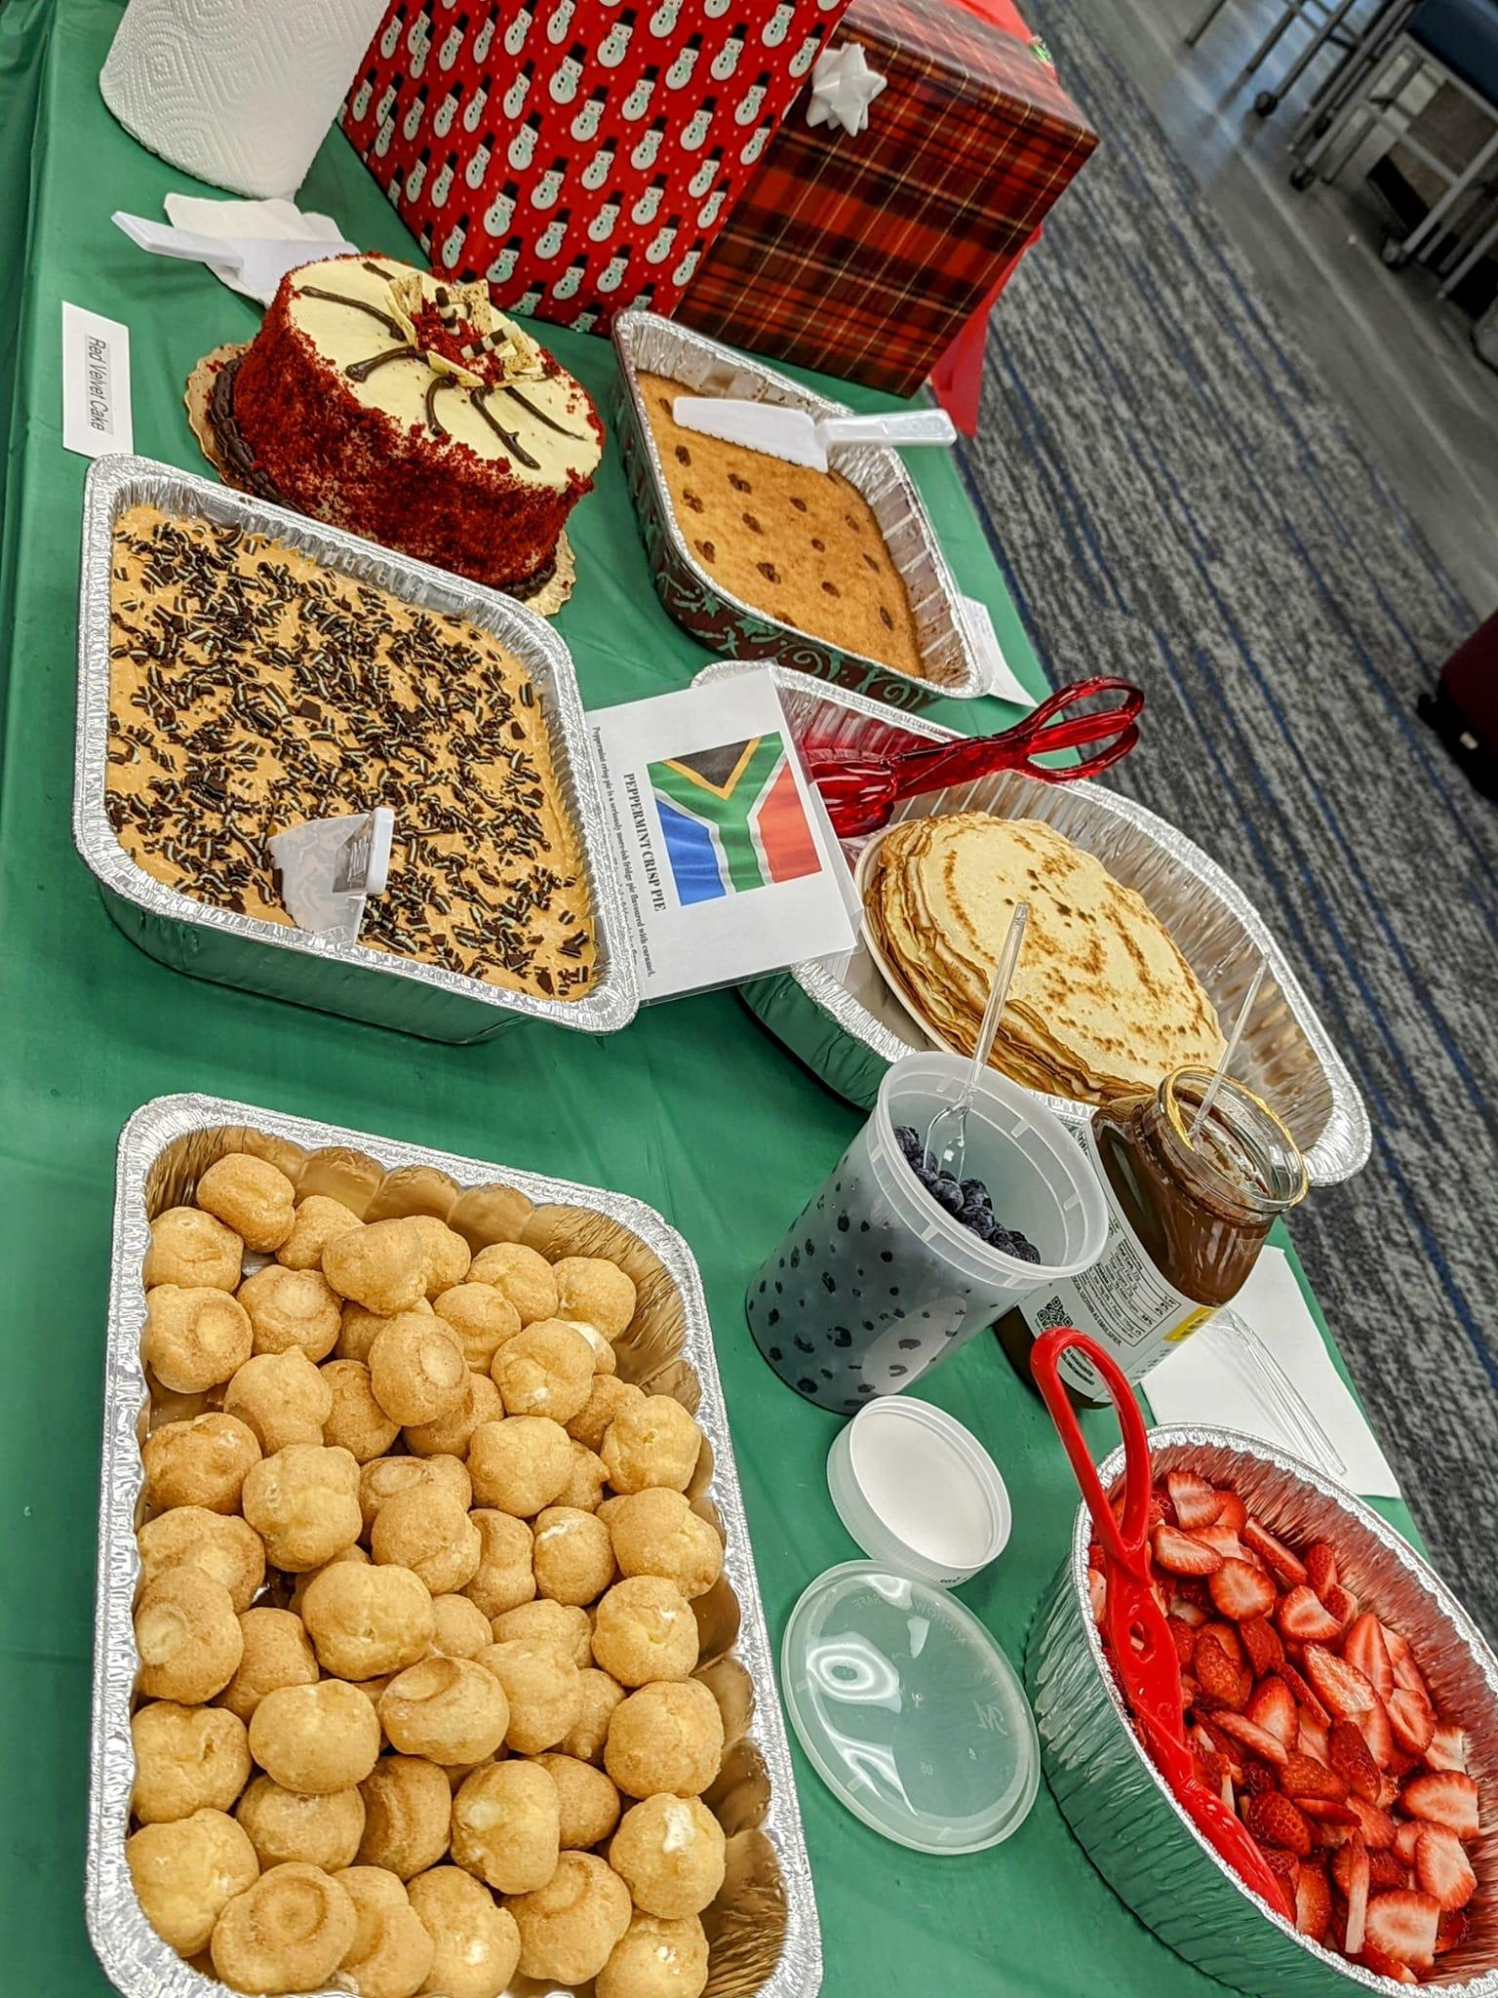
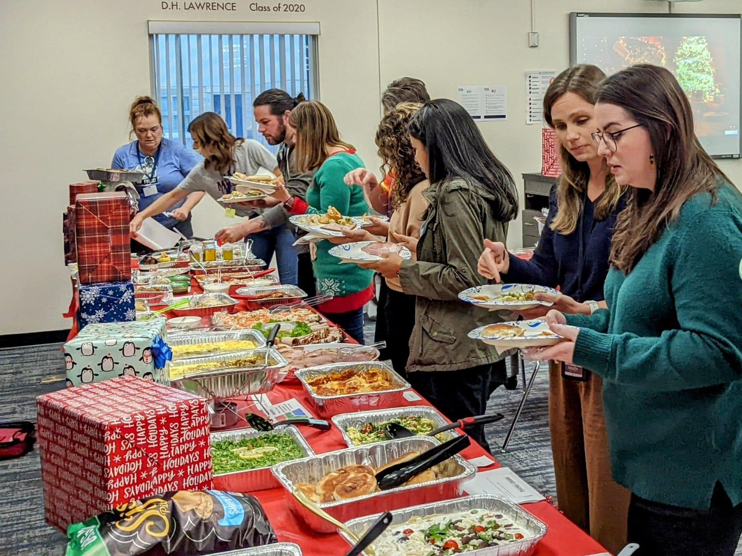
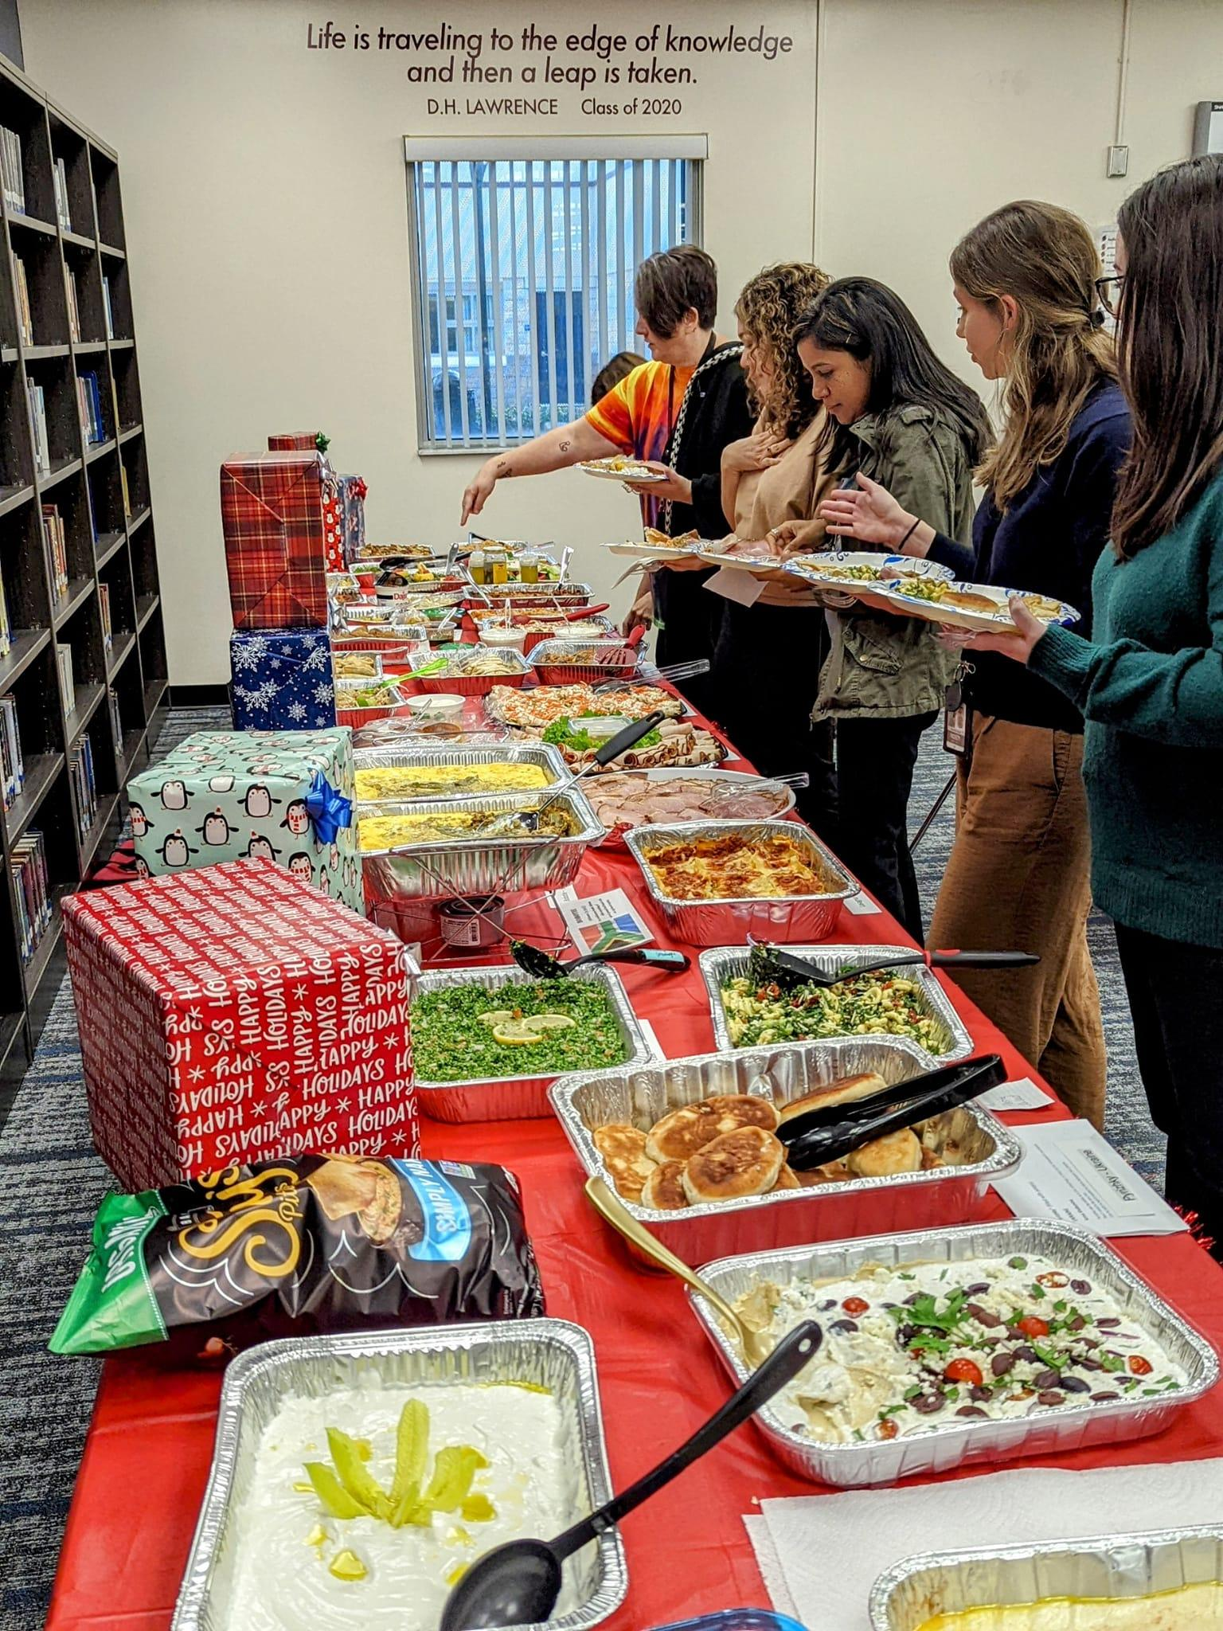
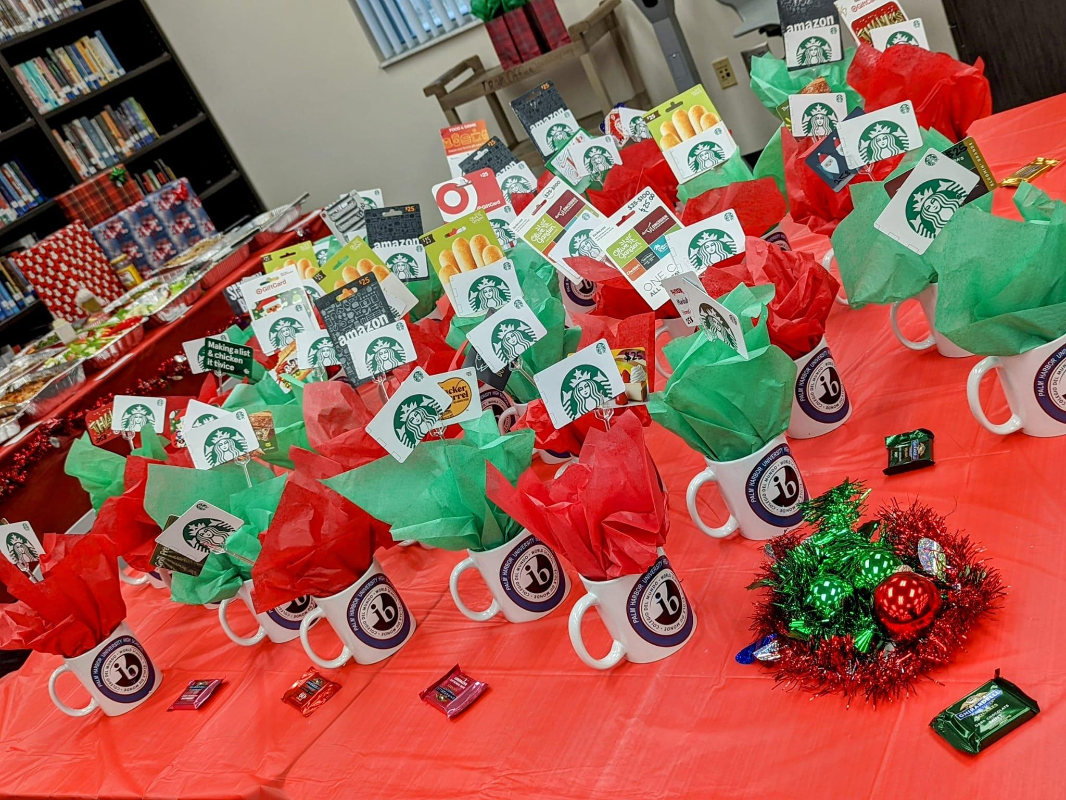
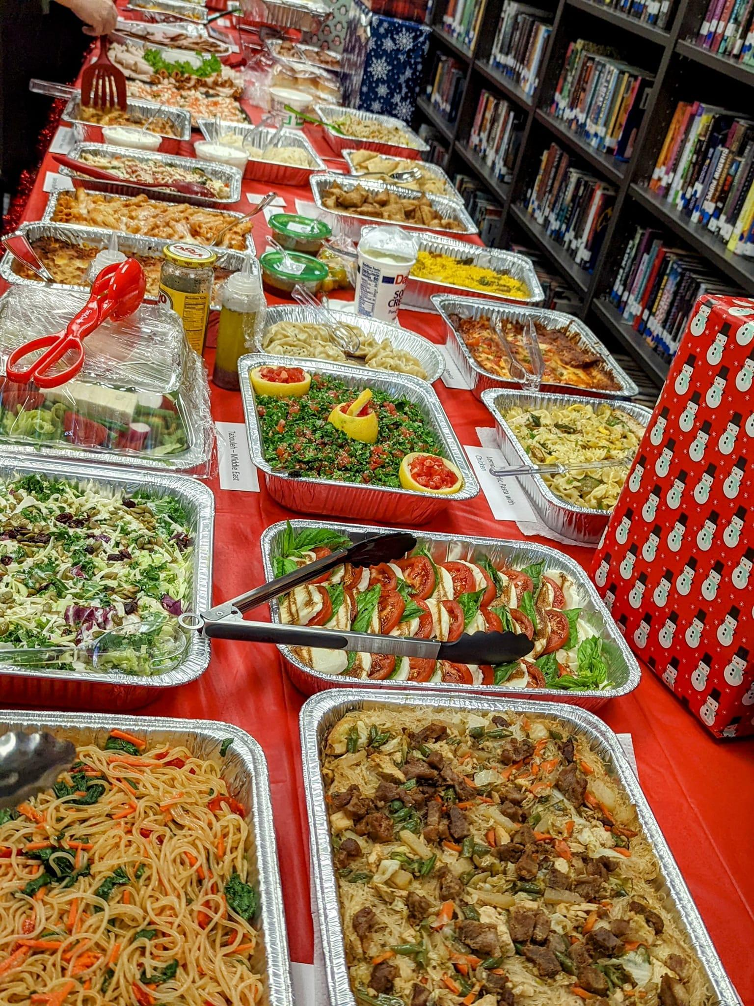
HOST THE TEACHERS ANNUAL HOLIDAY LUNCHEON
Notes:
This is another option for an overview using transitions to advance through several slides.

Slide 11
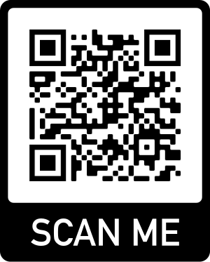
REMEMBER
VOLUNTEERING IS OPTIONAL, BOOSTERS DO THE WORK,
BUT WE NEED THE FUNDS!
BECOME A MEMBER TODAY!
WE CAN MAKE YOUR CHILD’S IB JOURNEY A GREAT ONE
Go online and sign up on our IB Booster Spirit Wear and Membership Page
https://phuhs-ib-online-spirit-wear.square.site

